Slide 1
Networking in the Cloud

Slide 2
Network architectures and standards

Slide 3
Introduction to Networks
Computer Networks are often differentiated based on the connection mode, like wired or wireless. They are categorized into different types depending on the requirement of the network channel.
The network established is used to connect multiple devices to share software and hardware resources and tools.
A computer network is a connection between two or more network devices, like computers, routers, and switches, to share network resources.

Slide 4
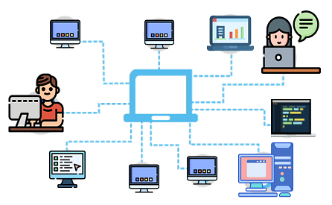

Slide 5
Types of Networks
According to the communication requirements, multiple types of network connections are available. The most basic type of network classification depends on the network's geographical coverage.

Slide 6
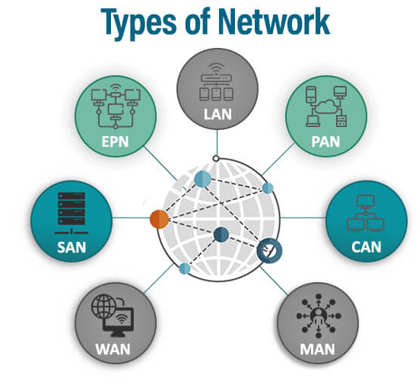
Types of Networks
Below mentioned are different types of networks:
PAN (Personal Area Network)
LAN (Local Area Network)
MAN (Metropolitan Area Network)
WAN (Wide Area Network)

Slide 7
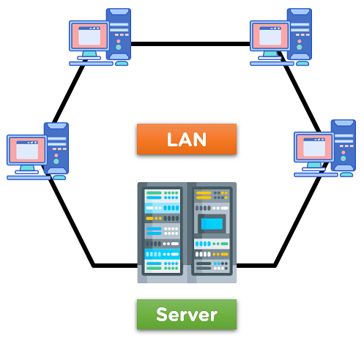
What Is Local Area Network (LAN)?
The Local Area Network (LAN) is designed to connect multiple network devices and systems within a limited geographical distance. The devices are connected using multiple protocols for properly and efficiently exchanging data and services.

Slide 8
Attributes of LAN Network
The data transmit speed in the LAN network is relatively higher than the other network types, MAN and WAN.
LAN uses private network addresses for network connectivity for data and service exchange, and it uses cable for network connection, decreasing error and maintaining data security.

Slide 9
Advantages and Disadvantages of LAN Network
Advantages | Disadvantages
Transmission of data and services is relatively higher than other network connections. | Need constant administration of experienced engineers for functioning.
The Network Server acts as a central unit for the whole network. | Probability of leak of sensitive data by LAN administration.

Slide 10
What Is Metropolitan Area Network (MAN)?
The Metropolitan Area Network (MAN) is a network type that covers the network connection of an entire city or connection of a small area. The area covered by the network is connected using a wired network, like data cables.

Slide 11
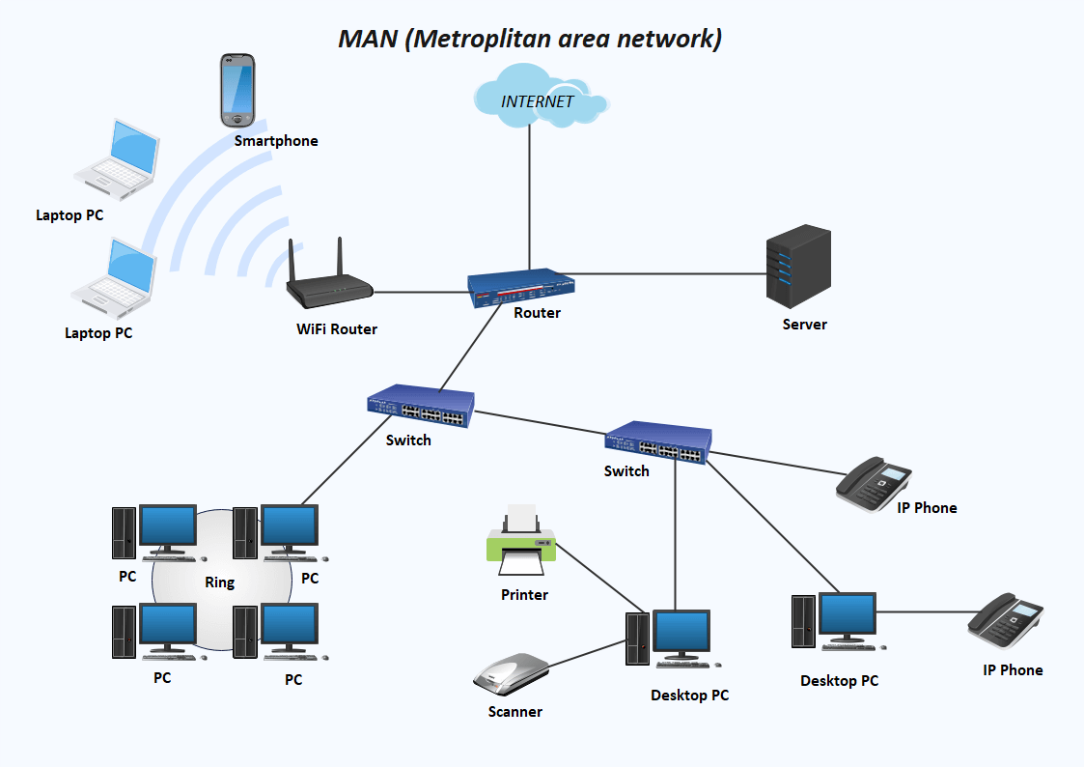

Slide 12
Attributes of MAN Network
Network covers an entire town area or a portion of a city.
Data transmission speed is relatively high due to the installation of optical cables and wired connections.

Slide 13
Advantages and Disadvantages of MAN Network
Advantages | Disadvantages
Provides Full-Duplex data transmission in the network channel for devices. | High probability of attack from hackers and cybercriminals due to large networks.
The network connection area covers an entire city or some parts using the optic cables. | The need for good quality hardware and the installation cost is very high.

Slide 14
What Is Wide Area Network (WAN)?
The Wide Area Network (WAN) is designed to connect devices over large distances like states or between countries. The connection is wireless in most cases and uses radio towers for communication.
The WAN network can be made up of multiple LAN and MAN networks.

Slide 15
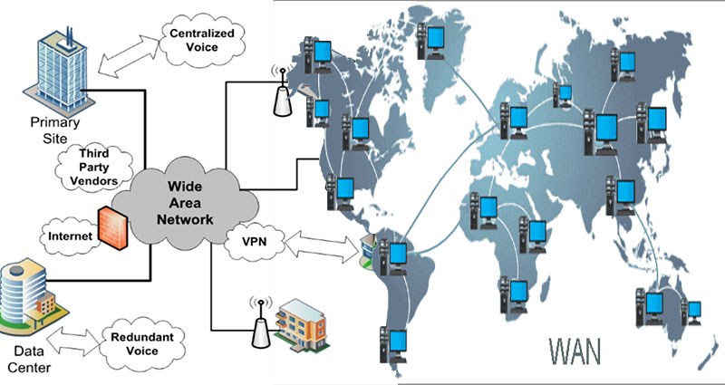

Slide 16
Attributes of WAN Network
The speed of the WAN data transfer is lower than in comparison to LAN and MAN networks due to the large distance covered.
The WAN network uses a satellite medium to transmit data between multiple locations and network towers.

Slide 17
Advantages and Disadvantages of WAN Network
Advantages | Disadvantages
This network covers a high geographical area and is used for large-distance connections. | High cost to set up the network and the Support of experienced technicians is needed to maintain the network.
They also use radio towers and connect channels for users. | It is difficult to prevent hacking and debug a large network.

Slide 18
Difference Between LAN, MAN, and WAN
Basis | LAN | MAN | WAN
Meaning | LAN is a network that enables the communication between many linked devices. It is in charge of establishing connections among neighborhood units, including universities and schools. | Several computers can be connected to MAN in the same city or separately. It encompasses a greater region, including minor towns and cities. | he WAN network extends to a much greater area. It can link multiple countries together.
Network Authority | LAN is a private and secured network. Hospitals, schools, offices, etc., can own it. | MAN can be either public or private. A lot of businesses and telephone companies could own them. | A single company may not own WAN. It can be private or public.
Speed | The Internet speed provided through LAN is fast. | MAN provides a modest Internet connection speed. | WAN provides a slow Internet connection.
Maintenance | LAN maintenance is very easy. | MAN's maintenance is easier compared to LAN. | WAN maintenance is very difficult.
Congestion | Congestion is less in the LAN network. | It is more in MAN. | Congestion is more in WAN when compared to LAN and MAN
Bandwidth | The bandwidth in LAN is very high. | In MAN, bandwidth is less. | WAN bandwidth is quite limited
Designing | It is very easy to design a LAN network. | It isn't easy to design a MAN network. | It is complicated to design WAN.

Slide 19
How to Set Up The Networks?
LAN
Ethernet is the foundation of all existing LANs, whether wired or wireless. Computers and servers can connect via cables or wirelessly. WiFi Access Points provide wireless connectivity in combination with a wired network. WAP-enabled devices serve as a link between PCs and networks. A WAP may connect a hundred or even a thousand wireless individuals to a network. Servers on a LAN are generally connected by wire.

Slide 20
MAN
A metropolitan area network combines many LANs with a fiber optic as the basis. It offers services akin to those offered by an internet service provider for broad area networks. MANs can use microwave or infrared lasers to connect Local Area Networks wirelessly. MANs are often owned by just one significant organization and are mainly created for towns or cities to give a high data connection.
WAN
Users and computers in one area may interact with users and computers in other locations via a WAN, composed of two or more interconnected Local Area Networks or Metropolitan Area Networks. Computers in a Wide Area Network are linked by public networks such as phone lines, satellite connections, or leased lines. To extend the network's capabilities across locations, costly leased lines are usually used to build WANs. At each end of a leased line, a router is attached.

Slide 21
How Do These Networks Function?
LAN
A local area network is a collection of computers and other technology with a common communication line or wireless network and, in most cases, the facilities of an individual server or processor within a limited geographic region. Typically, the server houses shared data storage and applications for many computer users.
MAN
Multiple LANs are connected by metropolitan area networks using specialized wireless and wired foundations. A MAN may link to a network exchange point and a local exchange carrier to offer connections between LANs and instantaneous communication between the MAN and the open Internet.
WAN
A point to another service that can employ traditional dial-up lines or modems to link the device to the phone line. Point-to-point WAN service suppliers include both local mobile phone providers and long-distance operators.

Slide 22
Characteristics of These Networks
LAN
LANs are simple to construct and maintain.
To link the LAN networks, a centralized database is needed.
A private owner owns the network.
MAN
The geographical region covered exceeds that of LAN.
Through this network, there is more than one computer connected.
WAN
WAN covers the biggest region, comparable to a nation.
WANs can be networked all over the world.
Through phone lines or satellites, the networks are connected.

Slide 23
Benefits of These Networks
LAN
Its main advantages are the local area network's rapid, simple setup and low cost.
Keeping everything stored on the server safe and secure is done through data protection.
LAN model and established ethernet cabling allow a system linked to a LAN to interact directly at a very high speed.
MAN
MAN offers more security than WAN and is simpler to deploy.
Due to MAN's lower resource requirements than WAN, MAN deployment costs are lower than WAN. It reduces the cost of implementation.
MANs may be controlled centrally, making network traffic monitoring and control easier.
WAN
WAN has a wide geographical coverage.
The information connected to every device in the relevant network can be shared through the WAN network.

Slide 24
Disadvantages of the Networks
LAN
Local area networks are only utilized in structures since they cannot be used in larger regions.
Unauthorized users may access data if the server's equipment is not appropriately configured and there is a technology issue.
There are restrictions on how many devices may be connected to LANs.
MAN
Because of the huge size, it is difficult to safeguard the system from hackers.
To link MAN from one location to another, extra cables are necessary. MAN necessitates the use of fiber optic connections, which are relatively costly.
MAN takes up a lot of space, making managing a big network difficult.
WAN
Because WAN networks combine more technologies, they have more security issues when compared to LAN and MAN networks.
Because of their enormous geographical coverage, WANs are complex and convoluted.
A lot of time must be spent troubleshooting the WAN network.

Slide 25
Wireless Local Area Network (WLAN)
WLAN or a wireless local area network functions like LAN as it transfers data in a small area. It is hardly compulsory for devices to have a wired connection that uses WLAN, and even though it is slightly weaker and less secure than other networks, a wireless local area network offers users the flexibility to use their devices in multiple locations. It is worth mentioning WLAN security can be strong if proper encryption methods like WPA3 are used.

Slide 26
How to Set Up?
Follow the steps mentioned below to set up a WLAN:
Get a WLAN router.
Visit the configuration page of your WLAN router.
Open the browser and enter the web address.
Now mention the provided username and password. These credentials come along with your router’s documentation.
Enter the information of your internet connection, including IP address and DNS, from your internet provider.
Open the wireless settings section to change the network name or password, enable or disable the wireless connection and set the encryption.
Ensure to click on save changes in your router’s settings.
Locate your WLAN router in a place like the central location that offers the best possible signal. Remember that obstacles such as doors or walls will disrupt your network.
Once a wireless network gets broadcasted by a router, connect the network to any device, like a laptop, mobile phone or tablet, by mentioning the password, and your WLAN network is ready to use.

Slide 27
How Does a Wireless Local Area Network (WLAN) Function?
In the wireless local area, is the type of network that transfers data through radio signals, and the data is forwarded in the form of a packet. Each packet includes labels, instructions, and layers, with a specific MAC address appointed for each endpoint. This helps routing data packets to appropriate locations.
It has a very high data switch rate and uses a star topology, where each node is connected to a central point. Moreover, an access point connects to the internet by promoting the transmission of frequency signals to the connected stations.

Slide 28
Characteristics
Some key characteristics of WLAN are listed below:
A wireless local area network is used to connect and interact with gadgets to the internet without using directed mediums, such as fiber or cables.
WLAN offers versatility by letting wireless devices connect and disconnect, avoiding physical wiring.
WLAN uses wireless connectivity to forward transmission, generating a more adaptable and dynamic network environment.
It uses radio waves to transfer records among devices, making it a flexible and useful alternative in multiple situations.

Slide 29
Advantages and Disadvantages
WLAN offers numerous advantages. Some of them are:
It is a reliable communication as it depends on reliable protocols.
WLAN setup is a clean and brief network, followed by a wireless setup, as it does not include any physical connections and is easier to install.
This network is advantageous for transforming physical layouts in dynamic workspaces. Businesses transferring and transforming offices do not affect network connectivity for longer periods as the setup doesn’t include heavy cable connections and can be reconnected quickly to new places.

Slide 30
Advantages and Disadvantages
WLAN network also comes with certain drawbacks, including:
Security issues regarding wireless local area networks are the major drawbacks. These networks can be easily attacked by hackers, resulting in the loss of crucial records, and information might be misused.
If multiple WLAN devices come with equal frequencies, together with cordless telephones or microwaves, there are chances of inflicting interference in this network. Hence, due to this network, the relationship might fail, resulting in connectivity issues.
Reliability problems might also occur in WLAN. The connection might turn much less steady in case of rain, excessive boundaries or other barriers between the device and the community router.

Slide 31
Campus Area Network (CAN)
The campus area network is utilized in most educational environments, such as schools or universities. Even though every school department might use WLAN, all the WLANs across the school can be connected through a CAN. Campus area networks include multiple independent networks in one unit. For instance, the Engineering and English departments can connect via a campus area network to directly communicate with one another.

Slide 32
How to Set Up?
CAN is a single network of multiple interconnected LANs that are connected via switches and routers. In CAN, nodes are connected via optical fiber media and take advantage of 10 Gigabit ethernet technology and wifi hotspots to access the network.

Slide 33
How Does Campus Area Network (CAN) Function?
A campus area network is created using access points and switches to link the devices and let them communicate with one another. In a CAN, devices get connected via wireless and wired technologies, such as Wi-Fi and ethernet. The wire connections are faster and highly reliable, which is why the wireless connections provide amazing mobility and flexibility. The IT team monitors the network traffic, troubleshoots issues, and configures the network settings.

Slide 34
Characteristics
CAN is a computer network usually located in places like big organizations or schools and colleges.
It covers only specific geographical areas.
CAN uses ethernet technology in a range of 1 to 5 km.
It comes with a very high transmission speed and a moderate cost.

Slide 35
Advantages and Disadvantages
Some benefits of the CAN are:
CANs offer reliable and fast connectivity for devices connected to the network.
As compared to WAN, CAN is less expensive to set up and maintain.
They can be scaled down or up easily when needed, making it a flexible option according to the fluctuating network requirements.
Drawbacks that are associated with the CAN include:
CAN is created to cover only small geographical areas and is not suitable for widely spread organizations.
They depend on physical infrastructure, such as access points, cables, or Wi-Fi, to connect devices. When any disruption occurs in the infrastructure, it affects the connectivity and performance of the CAN.
The cost associated with setting up and maintaining CAN is higher for organizations with limited budgets.

Slide 36
Storage Area Network (SAN)
It is a type of network that teams to store huge amounts of crucial data. It offers users a process to centralize data on non-localized networks that are different from the major operating ones.
How to Set Up?
To set up the storage area network, you must follow the guidelines listed below:
Assemble cable and other hardware components and install the software.
Change the configuration settings according to the requirements.
Test integrations, including the operational procedures for the SAN environment, along with failure mode, testing and backup, and normal production processing.
Create a performance baseline for each component and the entire SAN.
Document the SAN operational procedures and installation.

Slide 37
How Does the Storage Area Network (SAN) Function?
The storage area network aims to grab storage from an individual server and transport the storage where storage resources are centrally handled and protected. This centralization is performed by locating it into a storage subsystem. However, centralization can also be handled through software, which depends on virtualization to aggregate and manage the available storage.
In SAN, storage traffic performance is accelerated and optimized as the storage traffic doesn’t need to compete with the LAN required by servers and workloads. Hence, enterprise workloads can receive faster access to use volumes of storage. SAN is perceived as having three different layers, including a storage layer, a fabric layer, and a host layer.

Slide 38
Characteristics
Key characteristics of SAN include:
SAN is used to transfer data between the storage device and the server. It also promotes data transfer between storage systems.
SAN is mainly utilized to access storage devices, such as disk-based devices and tape libraries, from the servers.
It is a network which is not accessible via LAN. It includes switches, hosts, and storage devices that are interconnected through protocols, topologies, and technologies.

Slide 39
Advantages and Disadvantages
The major advantages of SAN are as follows:
SAN supports large deployment, including thousands of storage devices and SAN hosts, servers or storage systems. New storage and hosts are also added to build the SAN to align with the specific requirements of the organization.
A completely featured SAN deployment does not include any point of failure between a storage device and a host, and communications through the fiber always fetch an alternative path for storage availability to the workload.
SAN supports multiple useful storage features, such as data deduplication, data encryption, storage replication and self-healing technologies to maximize the storage capacity, data resilience and security.

Slide 40
Advantages and Disadvantages
Despite the multiple benefits, SANs come with certain limitations; they are:
SAN is effective only in complex and larger environments where there are multiple servers and enough storage. Moreover, the complexity and cost of SAN is hard to justify.
SAN management is a significant challenge as configuring features is problematic for busy organizations.
Setting up self-healing technologies and RAID is very time-consuming and cannot be avoided to maintain compliance with the organization.

Slide 41
Passive Optical Local Area Network (POLAN)
A passive optical local area network is a low-cost network linking multiple locations to a specific central network. It has the power to connect different entities to one information hub.
How to Set Up?
The passive optical local area network depends on single-mode fiber optic cables with few copper cables at the endpoints. It is created with multiple levels or layers of routers, ethernet cables, and active switches. The devices and core layer connect to distribution layer switches, which get linked to access layer switches in closets of communication. From these closets, copper cables run to the users' computers.

Slide 42
How Does a Passive Optical Local Area Network (POLAN) Function?
A passive optical network is a type of network that uses fiber or technology to transmit data from one source to several endpoints. This network is a point-to-multipoint indoor network structure, using optical splitters to allocate data from one source to multiple user endpoints. It also implements Wavelength Division Multiplexing technology to allow downstream and bi-directional upstream communication.
Characteristics
A passive optical network uses fiber optic technology to distribute data from one source to many endpoints.
The word ‘passive’ represents the usage of optical fiber cables that are linked to an unpowered splitter that forwards straighter from the service provider's network to different customers.

Slide 43
Advantages and Disadvantages
Some benefits of POLAN are as follows:
In comparison with traditional LAN, POLAN minimizes the number of devices and cables required in a network. These are smaller, less susceptible to interference, and have lighter cables, allowing POLANs to cover long distances and offer enhanced space.
POLAN centralizes management and intelligence and allows the delivery of all services through one infrastructure, reducing the requirement for several platforms.
Disadvantages of POLAN include:
In passive optical local area networks, short-term adoption is complex because of substantial investment in present copper networks.
Passive optical local area networks are not cost-effective network infrastructure for small organizations as they fail to utilize the entire capacity of this network.

Slide 44
Enterprise Private Network (EPN)
EPN, or Enterprise Private Network is an exclusive type of network created and operated by businesses to share company resources at rapid speeds. These are unique networks to a certain company, ensuring the security of the connection.
How to Set Up?
Setting up an EPN network includes installing switches, dedicated lines, security systems, routers, and potentially integrating cloud services.

Slide 45
How Does Enterprise Private Network (EPN) Function?
EPN includes connecting multiple components and devices within a specific organization, including branch offices, data centers and cloud services to promote business processes, data exchange, and network activity analysis. EPN starts with a local area network, connecting devices in a specific facility or location. Later, these local area networks are connected through wide area networks, enabling data transmission over longer distances. Hence, EPN is a complicated process that includes the connection of multiple components within a single organization to promote efficiency, data exchange, and other network activities, ensuring the reliability and security of the company's data.

Slide 46
Characteristics
EPN is a private network and not open to the public.
It is created to keep the communication and data of a company secure and confidential.
It is a highly scalable network and hence accommodates the rising needs of an organization as it grows.
These networks restrict connectivity to certain devices, users, and facilities. Moreover, they encrypt the data passing over them through virtual private networks or transport layer security encryption.

Slide 47
Advantages and Disadvantages
EPN offers the following advantages:
EPN provides enhanced security to organizations from outside threats and data leakage. With advanced trade detection technologies, companies can protect their crucial data and prevent unauthorized access.
Network optimization in EPN improves the enterprise network performance. A well-structured EPN promotes smooth data transfer, leading to better user satisfaction and increased productivity.
With a well-crafted EPN, companies handle changing technologies and growth effectively.
Drawbacks of EPN include the following:
EPN requires enough maintenance and set-up cost
Organizations require IT experts to manage the EPN network
EPN comes with the complexity of making sure every location is connected effectively.

Slide 48
Virtual Private Network (VPN)
A VPN is a kind of computer network, extending a private network across the Internet, and permitting the user to send and receive data like they were connected to a certain private network, even though they aren’t. By using a virtual point-to-point connection, users access a private network. It protects users from malicious threats by existing as a medium, giving you a protected network connection.
How to Set Up?
To set up a VPN connection:
Download a VPN app from the Internet.
Then open settings, click on network and select VPN.
Click on Add a VPN and mention the files for VPN type and server name, along with the account information provided to you by the VPN provider.

Slide 49
How Does Virtual Private Network (VPN) Function?
A VPN creates a digital connection between the remote server provided by a VPN provider and the computer, generating a point-to-point tunnel encrypting your data, masking your IP address, and allowing you to sidestep websites and firewalls on the Internet.
Characteristics
A virtual private network routes traffic via a remote server and encrypts it in the process.
When a VPN is connected to your network, it redirects the traffic of your Internet through a remote server before forwarding it to your destination.
VPN secures your data from malicious attackers, helps you protect your Internet traffic, and reduces your online footprint.

Slide 50
Advantages and Disadvantages
Using VPN offers multiple benefits:
Businesses get to secure their network through VPN. By using a VPN, your network is protected from software, people, and web browsers from getting access to your connection.
VPN lets you hide your private crucial information from hackers. Hence, with a VPN, you access high-level security, making all your online communications appear like garbled characters and text to hackers willing to access your data.
VPN has certain drawbacks. They are:
A VPN encounters an encryption process to secure your data, which takes excess time and can affect your online experience and reduce the Internet speed.
With little exposure to networking terminology, it can be challenging to understand and configure a VPN without a VPN provider.

Slide 51
System-Area Network (SAN)
A system area network is a local network that offers connections in groups. Multiple devices are connected to a system area network and operate in a single system. These are newly developed networks operating at higher speeds.
How to Set Up?
You can set up a system area network by assembling the cable and other components and installing the software. Now, set up the configurations according to your requirements and test integrations. After creating a performance baseline for the system area network and completing its installation, your network is ready to use.

Slide 52
How Does System-area Network (SAN) Function?
A system area network backs up data safely and keeps the data separate from the major server. However, the server acts as a transmission line, connecting the data stored on the system area network with the user on the other end.
Characteristics
The System Area Network is a separate network focusing on storing backups of shared data and resources.
It lets the registered users gain complete liberty of accessing the backup files.
This kind of network is preferred among organizations due to its ability to store data and resources with extreme security and end-to-end encryption.

Slide 53
Advantages and Disadvantages
The advantages of system media networks are as follows:
Data is not stored on the major network server, which is of great benefit as the user receives additional storage which can be utilized for other requirements.
SAN is capable of backing up data, especially over the system area network’s storing channels, which prevents resources from getting jam-packed within the LAN.
SAN comes with certain drawbacks, such as:
Firstly, system area networks are very costly and come with additional costs of continuous management and maintenance.
Functioning system media networks are very complex and can only be maintained and managed by specialists.

Slide 54
Advantages and Disadvantages
The advantages of system media networks are as follows:
Data is not stored on the major network server, which is of great benefit as the user receives additional storage which can be utilized for other requirements.
SAN is capable of backing up data, especially over the system area network’s storing channels, which prevents resources from getting jam-packed within the LAN.
SAN comes with certain drawbacks, such as:
Firstly, system area networks are very costly and come with additional costs of continuous management and maintenance.
Functioning system media networks are very complex and can only be maintained and managed by specialists.

Slide 55
Thank You !!!

